Slide 1

Parkinson’s Disease Detection using voice measurements
B. Harshith Reddy (167R1A05J5)
M. Yogendra (167R1A05M4)
M. Sreevasthava Theertha (167R1A05M6)
Under the guidance of
Dr. Raj Kumar Patra
(Professor)
Department of Computer Science and Engineering.

Slide 2
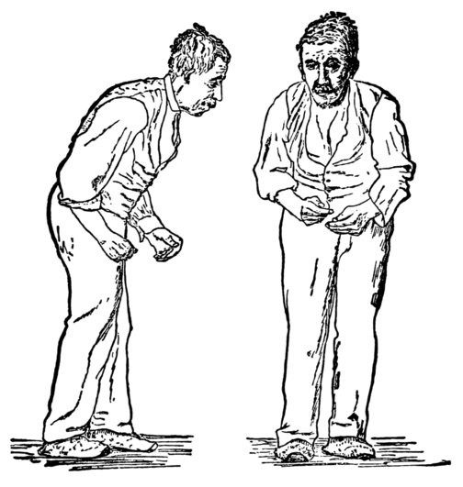
What is Parkinson's Disease?
Parkinson's disease (PD), or simply Parkinson's, is a long-term degenerative disorder of the central nervous system that mainly affects the motor system.
Early in the disease, the most obvious symptoms are shaking, rigidity, slowness of movement, and difficulty with walking.
Thinking and behavioral problems may also occur. Dementia becomes common in the advanced stages of the disease. Depression and anxiety are also common, occurring in more than a third of people with PD.
Other symptoms include sensory, sleep, and emotional problems. The main motor symptoms are collectively called "parkinsonism", or a "parkinsonian syndrome".

Slide 3
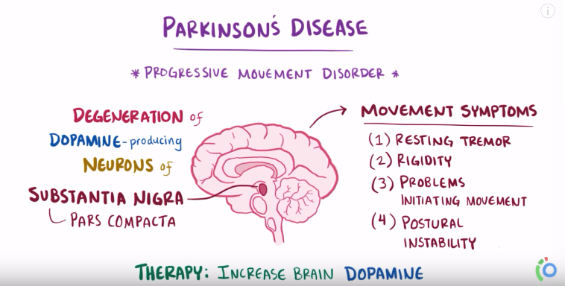
Cause of the disease!
The cause of Parkinson's disease is unknown, but is believed to involve both genetic and environmental factors. Those with a family member affected are more likely to get the disease themselves.
Genetics
Environmental factors
Exposure to pesticides and a history of head injury have each been linked with Parkinson disease

Slide 4
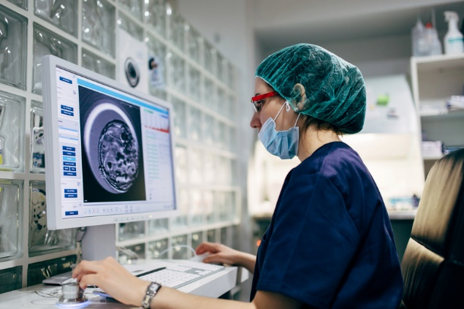
Applied Machine Learning in Healthcare.
Google has developed a machine learning algorithm to help identify cancerous tumors on mammograms.
Stanford is using a deep learning algorithm to identify skin cancer.
A recent JAMA article reported the results of a deep machine-learning algorithm that was able to diagnose diabetic retinopathy in retinal images.

Slide 5
Data Drives Machine Learning.
As more data is available, we have better information to provide patients. Predictive algorithms and machine learning can give us a better predictive model of mortality that doctors can use to educate patients.
But machine learning needs a certain amount of data to generate an effective algorithm. Much of machine learning will initially come from organizations with big datasets. Health Catalyst is developing Collective Analytics for Excellence (CAFÉ™), an application built on a national de-identified repository of healthcare data from enterprise data warehouses (EDWs) and third-party data sources. It is enabling comparative effectiveness, research, and producing unique, powerful machine learning algorithms. CAFÉ provides a collaboration among our healthcare system partners, big and small.

Slide 6
Details of the Data-Set:
Source:
The dataset was created by Max Little of the University of Oxford, in collaboration with the National Centre for Voice and Speech, Denver, Colorado, who recorded the speech signals. The original study published the feature extraction methods for general voice disorders.
Data Set Information:
This dataset is composed of a range of biomedical voice measurements from 31 people, 23 with Parkinson's disease (PD). Each column in the table is a particular voice measure, and each row corresponds one of 195 voice recording from these individuals ("name" column). The main aim of the data is to discriminate healthy people from those with PD, according to "status" column which is set to 0 for healthy and 1 for PD.

Slide 7
Attributes of the Data Used:
name - ASCII subject name and recording number
MDVP: Fo(Hz) - Average vocal fundamental frequency
MDVP: Fhi(Hz) - Maximum vocal fundamental frequency
MDVP: Flo(Hz) - Minimum vocal fundamental frequency
MDVP: Jitter(%),
MDVP: Jitter(Abs),
MDVP:RAP,
MDVP:PPQ,
MDVP:APQ
Jitter: DDP - Several measures of variation in fundamental frequency
MDVP: Shimmer,
MDVP: Shimmer(dB),
Shimmer:APQ3,
Shimmer:APQ5,
Shimmer: DDA - Several measures of variation in amplitude
NHR,HNR - Two measures of ratio of noise to tonal components in the voice
status - Health status of the subject (one) - Parkinson's, (zero) - healthy
RPDE,D2 - Two nonlinear dynamical complexity measures
DFA - Signal fractal scaling exponent spread1,spread2,PPE - Three nonlinear measures of fundamental frequency variation

Slide 8
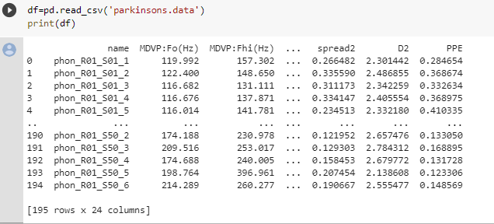
Screenshot of Data-Set Used:

Slide 9
Ensemble learning:
So what is XGBoost and where does it fit in the world of ML?
Gradient Boosting Machines fit into a category of ML called Ensemble Learning, which is a branch of ML methods that train and predict with many models at once to produce a single superior output.
Ensemble learning is broken up into three primary subsets:
Bagging
Stacking
Boosting

Slide 10

What is XGBoost?
XGBoost is a new Machine Learning algorithm designed with speed and performance in mind. XGBoost stands for eXtreme Gradient Boosting and is based on decision trees. In this project, we will import the XGBClassifier from the xgboost library; this is an implementation of the scikit-learn API for XGBoost classification.

Slide 11
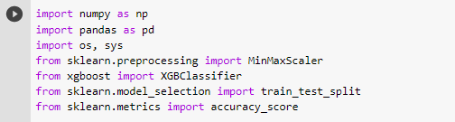
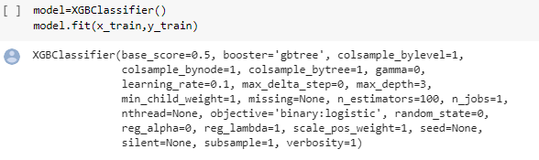
Libraries and Algorithm Used:
Libraries
Model Building.

Slide 12

Output of the project:
The accuracy of the model we built is approximately 95%

Slide 13
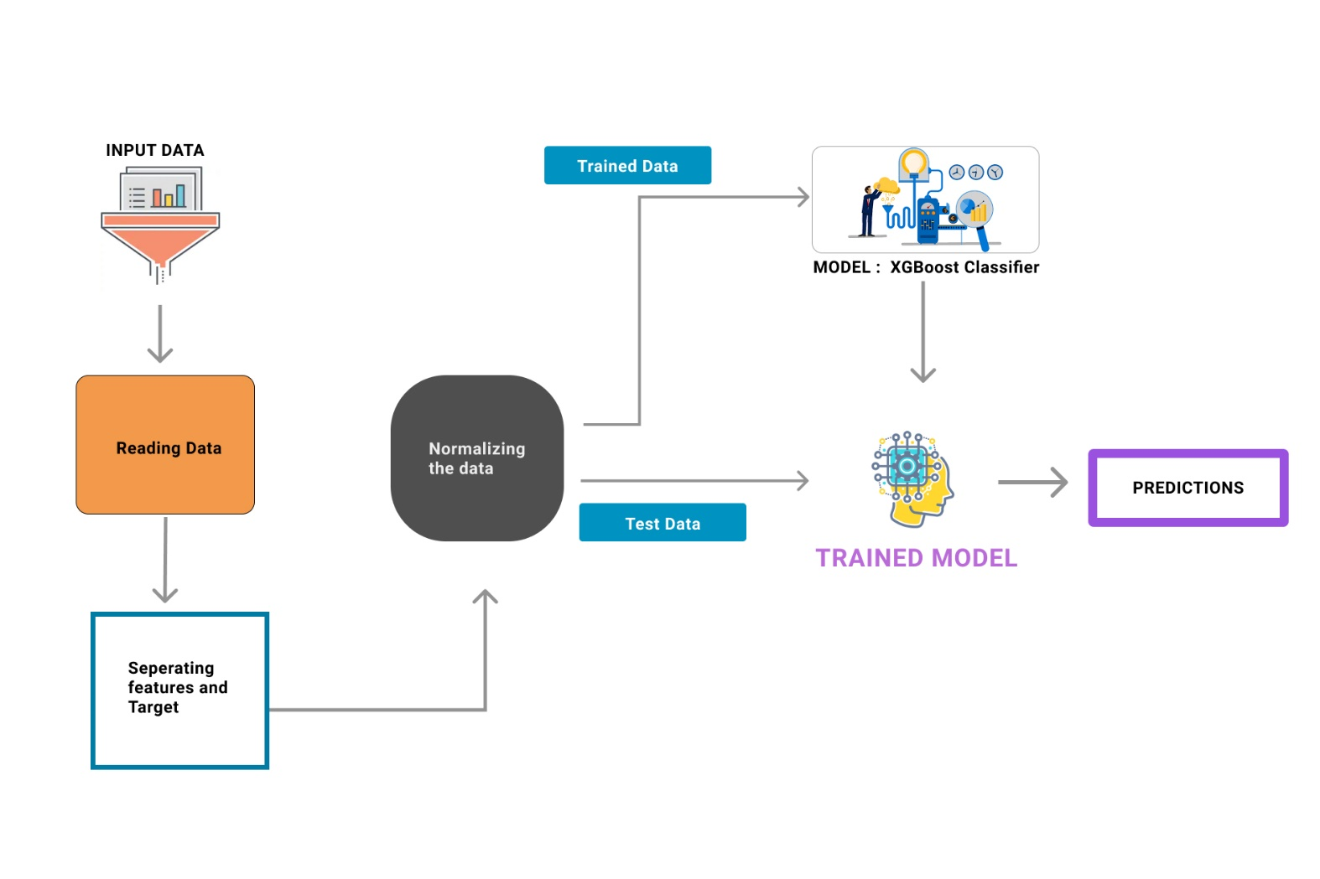
Architecture:

Slide 14
Research Work Status:
Research in Parkinson's disease has made remarkable progress. There is very real hope that the causes, whether genetic or environmental, will be identified and the precise effects of these causes on brain function will be understood.
How Could Stem Cells Help People With Parkinson's ?
Stem cells are the parent cells of all tissues in the body. This means they can turn in to any type of cell. The hope is that they will eventually be able to make these cells into specific types of cells, like dopamine-producing neurons, that can be used to treat Parkinson's disease. However, there are concerns that patients may have the same risk of increased involuntary movements as those who undergo fetal cell transplantation. And, like fetal cell transplantation, stem cell therapy is surrounded by moral and ethical controversy.

Slide 15
Software Requirements:
Operating System : Windows / Linux
IDE : Jupyter Notebook
Programming Language : Python 3
Python Packages : Numpy, Pandas, Sklearn, XGBoost

Slide 16
Hardware Requirements:
Processor : core i3 or higher
Hard Disk : 500GB or higher
RAM : 4GB or higher

Slide 17
Thank You!

